Slide 1
Constraint Satisfaction Problem

Slide 2
Constraint Satisfaction Problem (CSP)
A problem is solved when each variable has a value that satisfies all the constraints on the variable. A problem described this way is called a constraint satisfaction problem, or CSP.
The main idea is to eliminate large portions of the search space all at once by identifying variable/value combinations that violate the constraints.

Slide 3
Definition of CSP
Constraint satisfaction problem consists of three components, X, D, and C:
X is a set of variables, {X1,...,X,}.
D is a set of domains, {D,...,D,}, one for each variable.
C is a set of constraints that specify allowable combinations of values.
A domain, D, consists of a set of allowable values, {v1,..., vn}, for variable X;.
For example, a Boolean variable would have the domain {true,false}.
Each constraint C_{j} consists of a pair (scope, rel),
where scope is a tuple of variables that participate in the constraint
rel is a relation that defines the values that those variables can take on.

Slide 4
A relation can be represented as an explicit set of all tuples of values that satisfy the constraint, or as a function that can compute whether a tuple is a member of the relation.
For example, if X1 and X2 both have the domain {1,2,3}, then the constraint saying that X1; must be greater than X2 can be written as,
((X1,X2),{(3,1),(3,2),(2,1)}) or as ((X1, X2), X1 > X2).

Slide 5
CSPs deal with assignments of values to variables, {Xi = vi,Xj =vj,...}.
An assignment that does not violate any constraints is called a consistent or legal assignment.
A complete assignment is one in which every variable is assigned a value, and a solution to a CSP is a consistent, complete assignment.
A partial assignment is one that leaves some variables unassigned, and a partial solution is a partial assignment that is consistent.

Slide 6
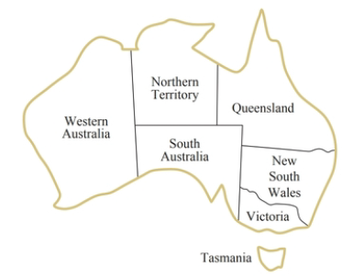
Example problem: Map coloring
A map of Australia showing each of its states and territories.
We are given the task of coloring each region either red, green, or blue in such a way that no two neighboring regions have the same color.

Slide 7
Example problem: Map coloring
We define the variables to be the regions:
X = {WA,NT,Q,NSW,V,SA,T}.
The domain of every variable is the set
Di = {red, green, blue}.
The constraints require neighboring regions to have distinct colors.
Since there are nine places where regions border, there are nine constraints:
C = {SA≠ WA, SA ≠ NT, SA ≠ Q, SA ≠ NSW, SA ≠ V,
WA ≠ NT, NT ≠ Q, Q ≠ NSW, NSW ≠ V}.

Slide 8
Example problem: Map coloring
Here we using arc abbreviations; SA ≠ WA is a shortcut for ((SA,WA),SA ≠ WA),
Where SA ≠ WA can be fully enumerated in turn as
{(red, green), (red. blue), (green, red), (green, blue), (blue, red), (blue, green) }.
Solutions to this problem?

Slide 9
Example problem: Map coloring
There are many possible solutions to this problem, such as
{WA =red, NT=green, Q= red, NSW = green, V = red, SA=blue, T = red }.

Slide 10
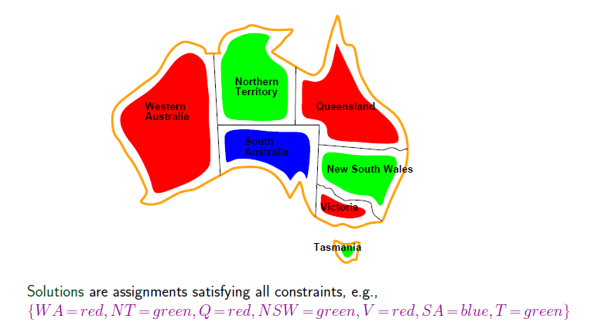

Slide 11
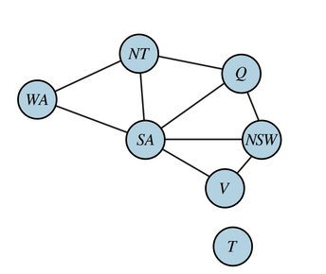
Example problem: Map coloring
It can be helpful to visualize a CSP as a constraint graph, as shown in Figure.
The nodes of the graph correspond to variables of the problem, and an edge connects any two variables that participate in a constraint.

Slide 12
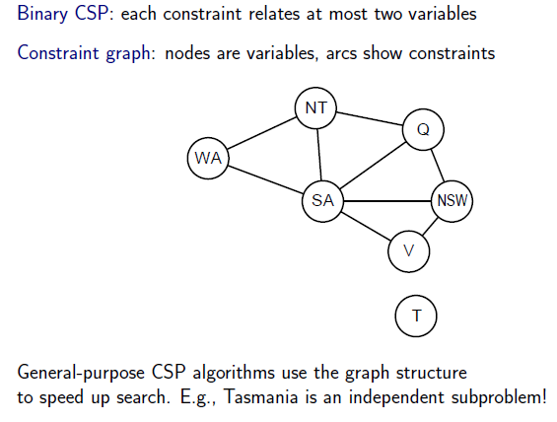
Constraint graph

Slide 13
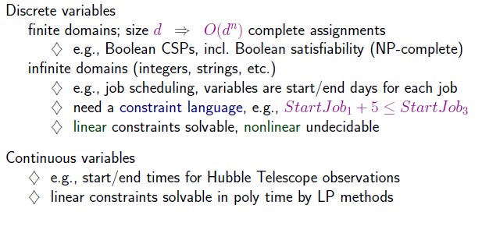
Types of CSP

Slide 14
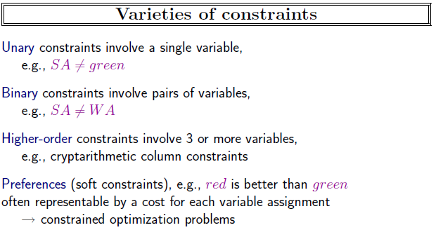

Slide 15
Cryptarithmetic Problem
Cryptarithmetic Problem is a type of constraint satisfaction problem where the game is about digits and its unique replacement either with alphabets or other symbols.
In cryptarithmetic problem, the digits (0-9) get substituted by some possible alphabets or symbols.
The task in cryptarithmetic problem is to substitute each digit with an alphabet to get the result arithmetically correct.

Slide 16
Rules and constraints
There should be a unique digit to be replaced with a unique alphabet.
The result should satisfy the predefined arithmetic rules, i.e., 2+2 =4, nothing else.
Digits should be from 0-9 only.
The problem can be solved from both sides, i.e., lefthand side (L.H.S), or righthand side (R.H.S)

Slide 17
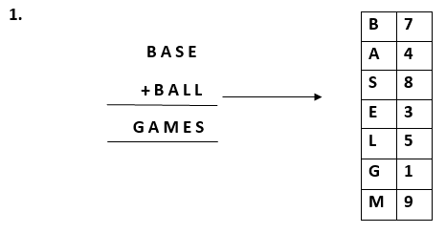
Example-1

Slide 18
Example-1
Variables: {B,A,S,E,L,G,M}
Domain:{0,1,2,3,4,5,6,7,8,9}
Constraint: AllDiffz(B,A,S,E,L,G,M)

Slide 19
Example-1
B | 5
B | 5
G A | 10
G | 1
A | 0

Slide 20
Example-1
B | 6
B | 6
G A | 12
G | 1
A | 2

Slide 21
Example-1
Cr | 0 | Cr | 0
B | 6 | A | 2
B | 6 | A | 2
G A | 12 | M | 4
G | 1
A | 2

Slide 22
Example-1
Cr | 0 | Cr | 0 | Cr
B | 6 | A | 2 | S | 3
B | 6 | A | 2 | L | 5
G A | 12 | M | 4 | E | 8
G | 1
A | 2

Slide 23
Example-1
Cr | 0 | Cr | 0 | Cr |  | Cr
B | 6 | A | 2 | S | 3 | E | 8
B | 6 | A | 2 | L | 5 | L | 5
G A | 12 | M | 4 | E | 8 | S
G | 1
A | 2

Slide 24
Example-1 Solution
Cr | 0 | Cr | 0 | Cr |  | Cr
B | 7 | A |  | S |  | E
B | 7 | A |  | L |  | L
G A | 14 | M |  | E |  | S
G | 1
A | 4

Slide 25
Example-1 Solution
Cr | 0 | Cr | 0 | Cr |  | Cr
B | 7 | A | 4 | S |  | E
B | 7 | A | 4 | L |  | L
G A | 14 | M | 8 | E |  | S
G | 1
A | 4

Slide 26
Example-1 Solution
Cr | 0 | Cr | 1 | Cr |  | Cr
B | 7 | A | 4 | S | 8 | E
B | 7 | A | 4 | L | 5 | L
G A | 14 | M | 9 | E | 3 | S
G | 1
A | 4

Slide 27
Example-1 Solution
Cr | 0 | Cr | 1 | Cr | 0 | Cr | 0
B | 7 | A | 4 | S | 8 | E | 3
B | 7 | A | 4 | L | 5 | L | 5
G A | 14 | M | 9 | E | 3 | S | 8
G | 1
A | 4

Slide 28


Slide 29


Slide 30
Cr |  | Cr |  | Cr |  | Cr
S |  | E |  | N |  | D
M |  | O |  | R |  | E
MO |  | N |  | E |  | Y
M
O
Notes:
9567 1085

Slide 31
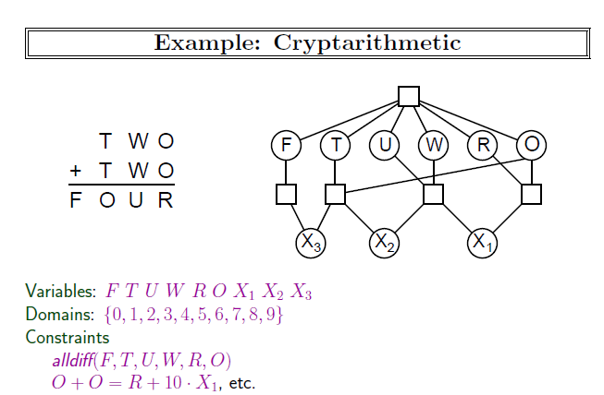

Slide 32
Cr | 0 | Cr | 0 | Cr | 0
T | 7 | W | 3 | O | 4
T | 7 | W | 3 | O | 4
FO | 14 | U | 6 | R | 8
F | 1
O | 4

Slide 33
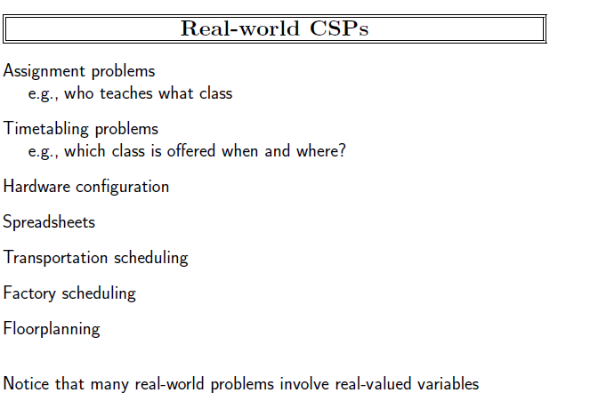

Slide 34
